Slide 1

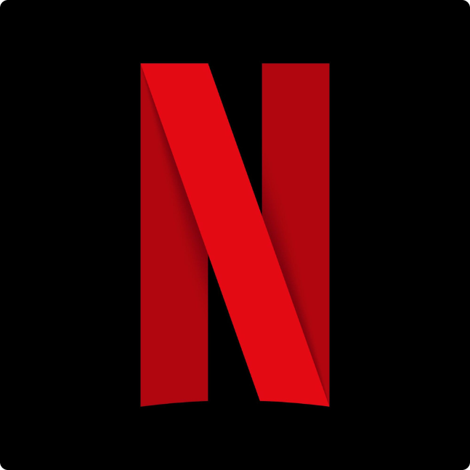
Overview of Netflix Original Movies
Netflix has amassed an impressive library of original movies spanning various genres, from dramatic thrillers to heartwarming comedies. These films have captivated audiences worldwide with their compelling stories and high-caliber production values.

Slide 2
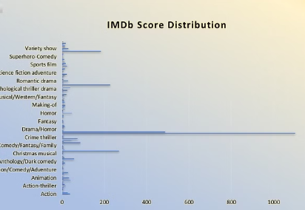
IMDb Scores for Netflix Originals
Top Rated
Average Scores
Netflix originals based on Genre like Drama and horror have consistently high IMDb scores, reflecting their critical acclaim and popularity among viewers.
The majority of Netflix original movies like of thriller drama or Fantasy maintain solid IMDb scores, indicating a commitment to quality storytelling and production across the platform's diverse film offerings.

Slide 3

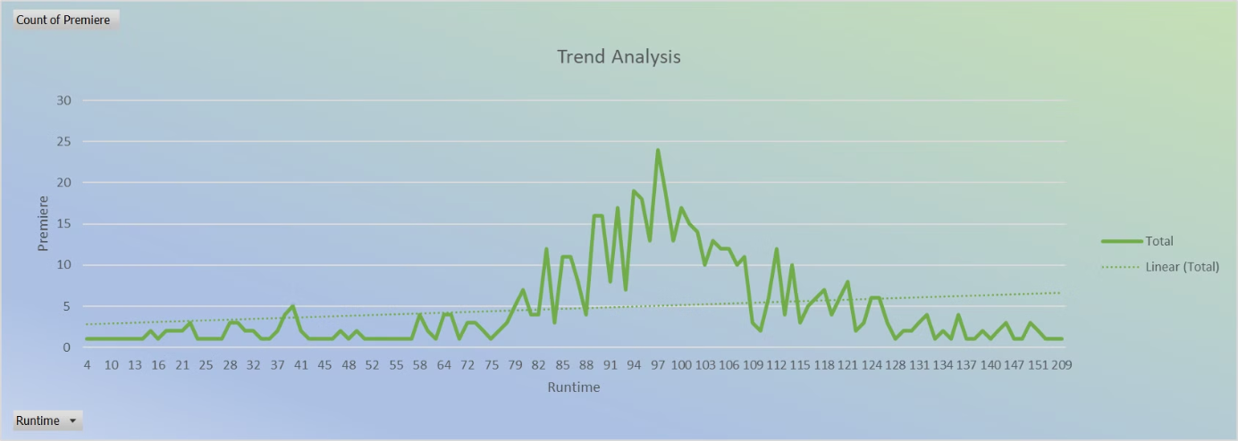
Trends in Netflix Original Movie Ratings

Slide 4
Comparison of IMDb Scores by Netflix Original Movie Genre
Drama
Comedy
Action/Thriller
Netflix's dramatic offerings, such as "Mudbound" and "Marriage Story," have consistently received high IMDb scores, reflecting the platform's ability to produce compelling and emotionally resonant films.
Netflix's comedic original movies, like "The Prom" and "Eurovision Song Contest: The Story of Fire Saga," have garnered strong IMDb ratings, showcasing the platform's talent for delivering hilarious and heartwarming content.
Netflix's action and thriller films, including "Extraction" and "Project Power," have also earned impressive IMDb scores, demonstrating the platform's expertise in delivering thrilling and suspenseful cinematic experiences.

Slide 5
Language Preferences based On IMDB score
1
English Dominance
2
Foreign Language Gems
3
Multilingual Potential
Netflix's English-language original movies, such as "The Trial of the Chicago 7" and "Mank," have consistently received high IMDb scores, reflecting the platform's ability to produce critically acclaimed films in this language.
Netflix's foreign language original films, like the Spanish-language "Alehandro" and the French-language "The Intouchables," have also garnered impressive IMDb ratings, showcasing the platform's commitment to diversifying its offerings.
As Netflix continues to expand its global reach, the platform has the opportunity to further explore and celebrate the cinematic talents of diverse language communities, potentially leading to even more highly-rated original films.

Slide 6
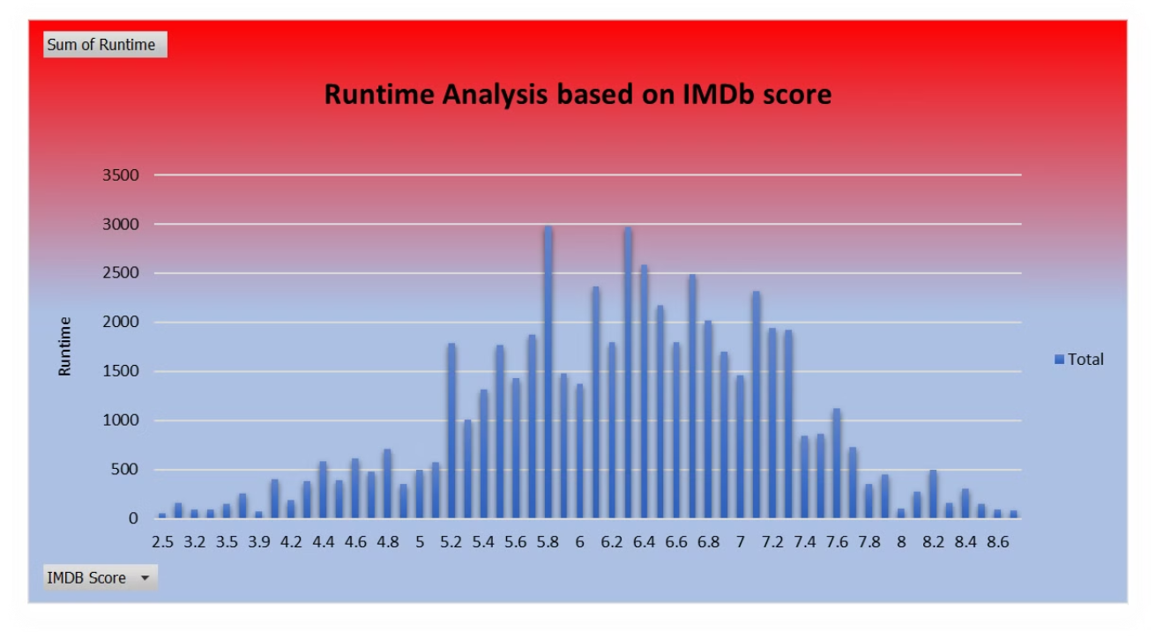
Runtime Analysis for Netflix Movies

Slide 7
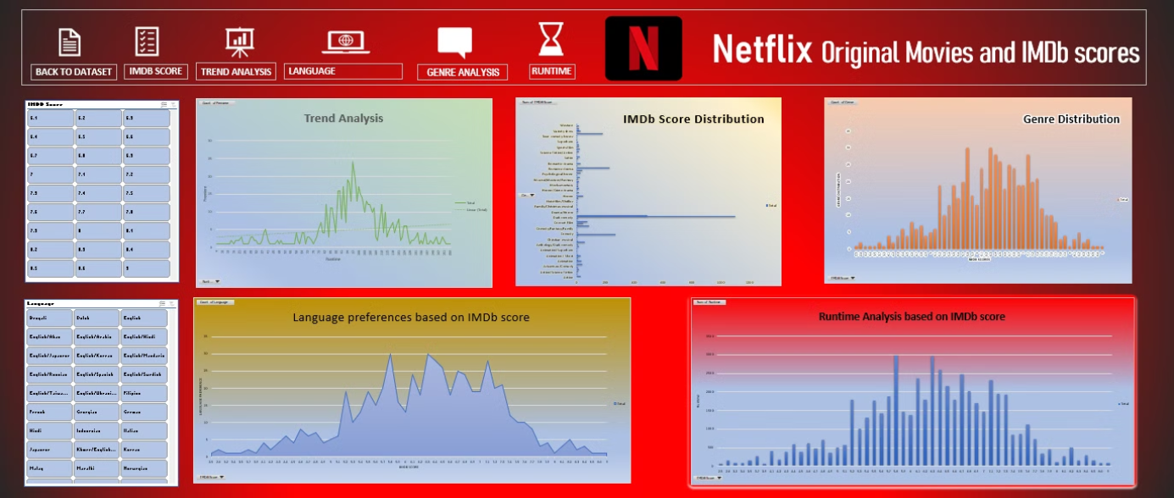
Dashboard

